Slide 1
Computer Organization and Architecture Activity

Slide 2
Problem statement
Design and simulate a 4M *16 memory module using 256K*8 SRAM.
Perform read and write operation for above memory.

Slide 3
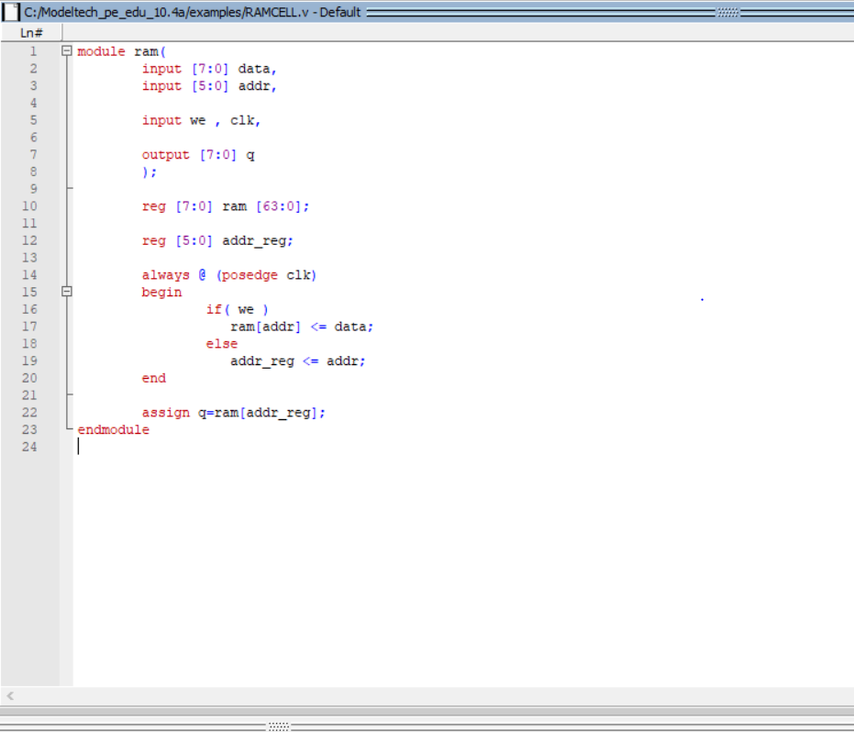
Survey on Simulation Tools
Modelsim: It is a high end simulation software. It provides HDL simulations like VHDL, Verilog and system C. We tried with simulation of a single RAM cell in modelsim.
It is widely used by students for their
Academic work and course projects.
Below is a sample simulation of a
RAM module

Slide 4
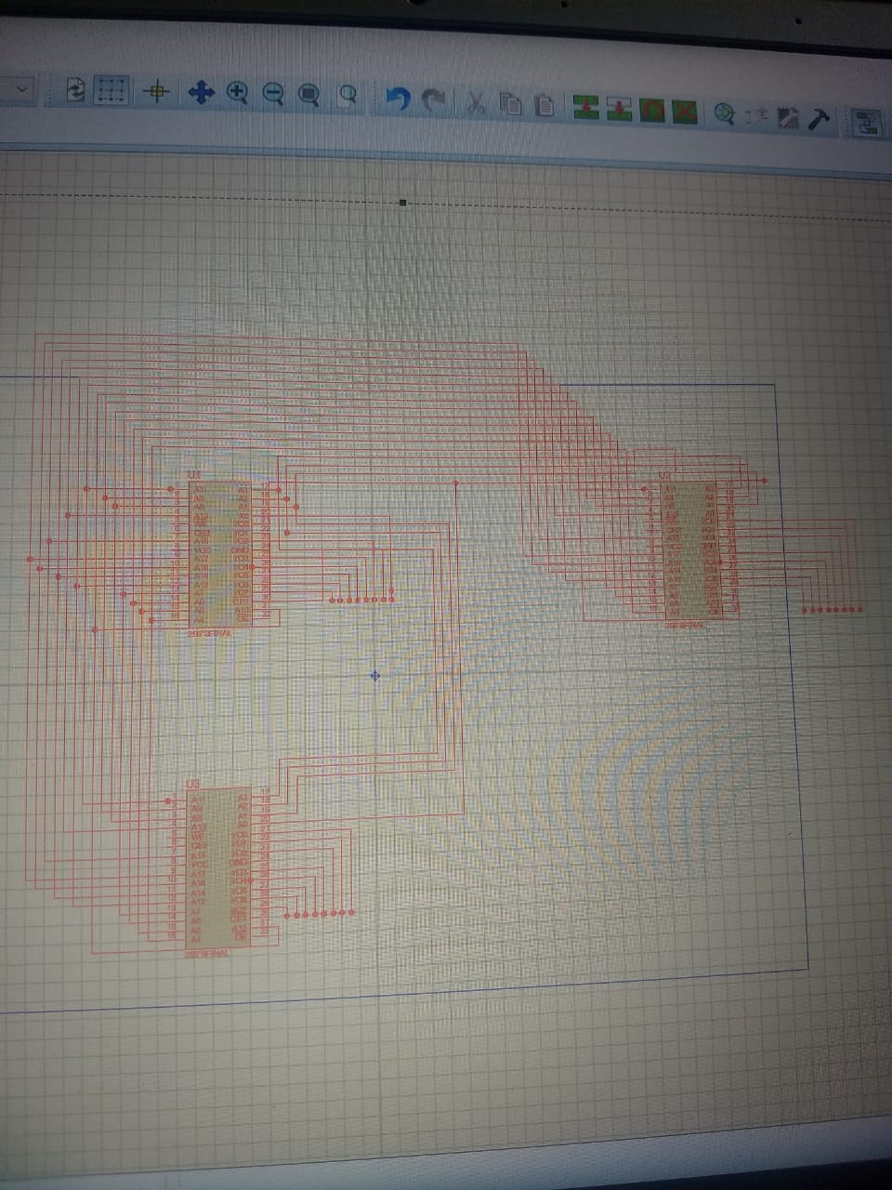
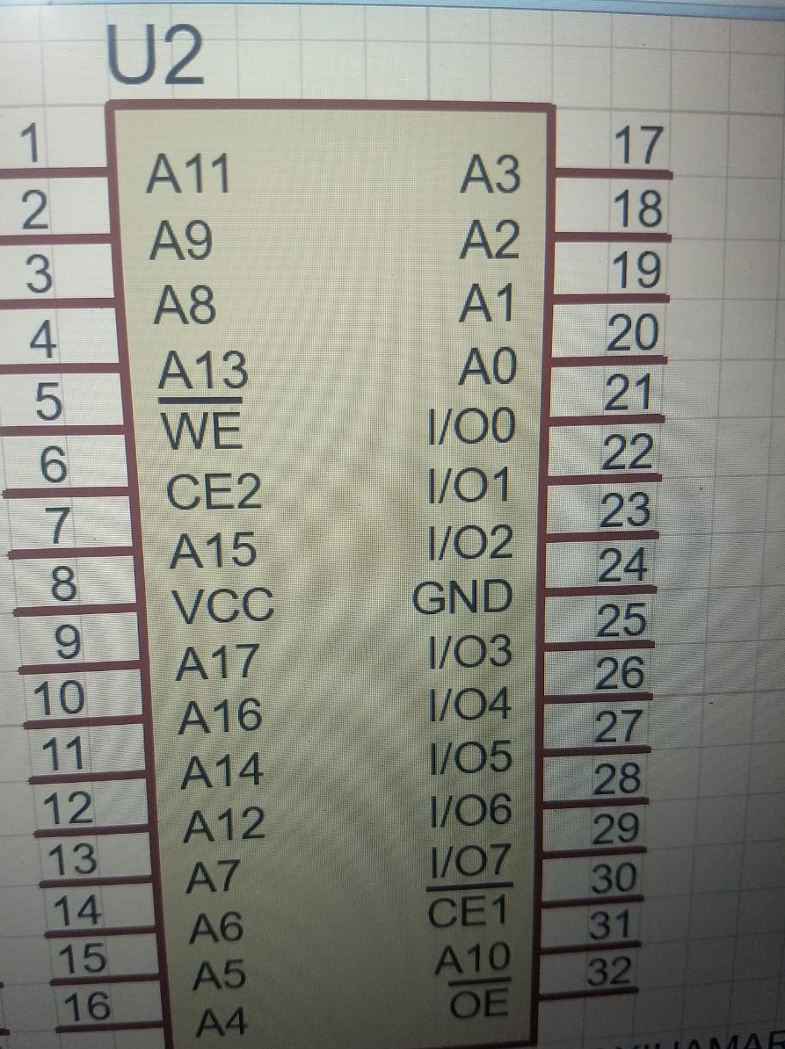
Proteus:
The most commonly used simulation software by students. It has a got very rich libraries which make possible to simulate any kind of circuit.
Its also used in electronic prints for manufacturing of printed circuit board.
Below is a sample simulation of RAM in
proteus using RAM IC CY62138FV30LL
which is 256K*8 IC

Slide 5
Logisim –It’s a simulator which permits circuits to be designed and simulated using graphical user interface. It’s a java application that can run on both windows and Linux.
We have chosen Logisim as our simulation tool because :
Provides easy to use interface environment.
Easy to draw and simulate circuits.
Flexible
Large number of memory modules can be designed easily.
Components can be modified easily according to our need.
Good tool for beginners for learning circuit simulations

Slide 6
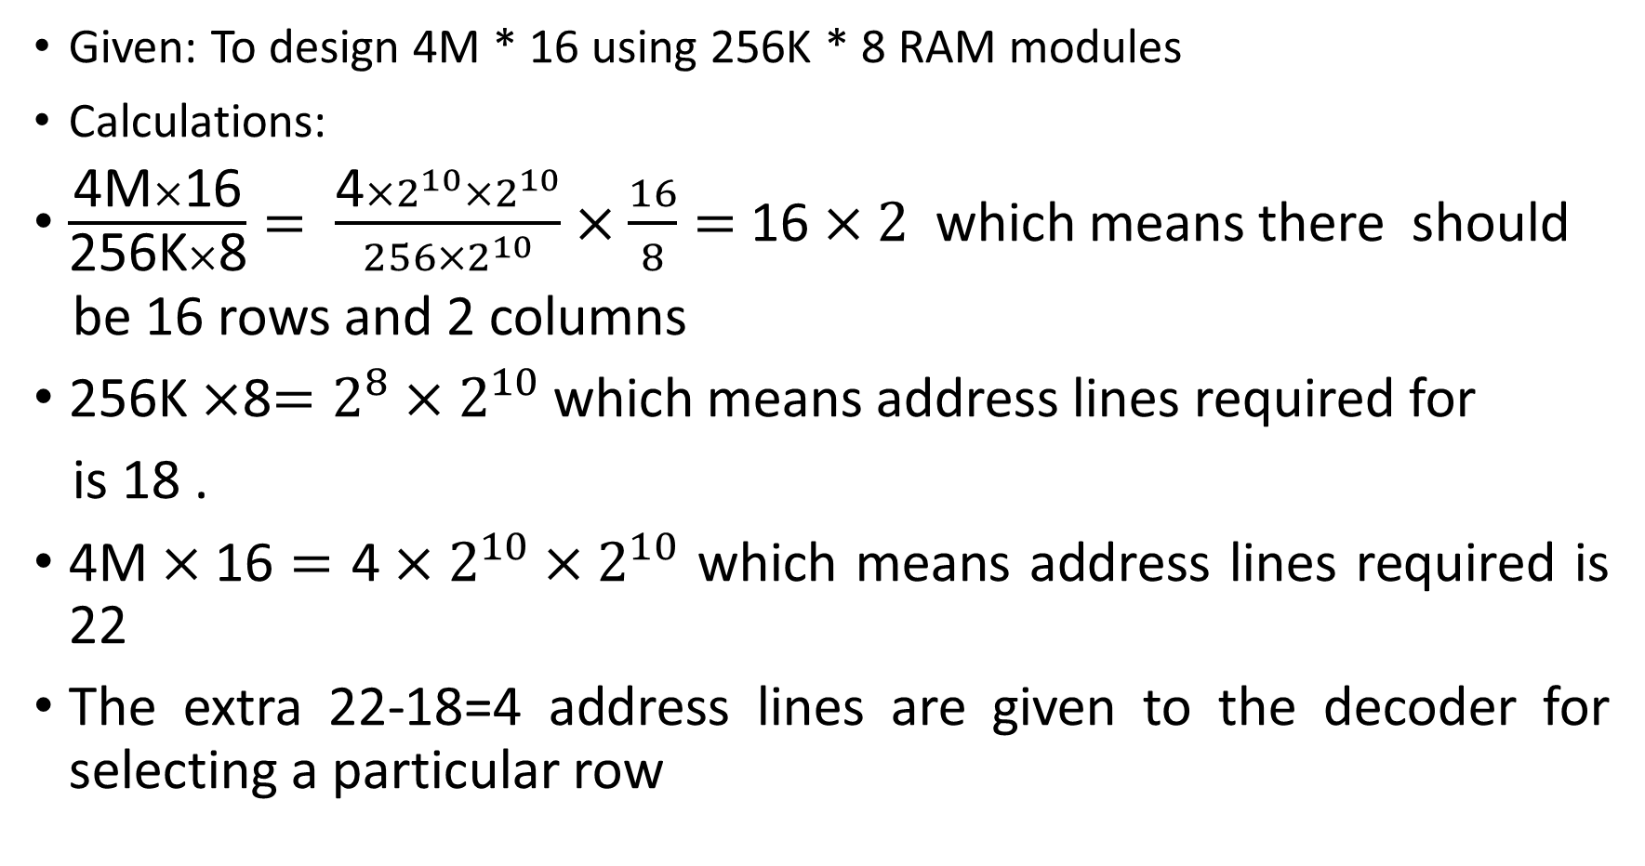
Analysis of the problem statement
Given: To design 4M * 16 using 256K * 8 RAM modules
Calculations:
$\frac{\text{4}\text{M}×\text{16}}{\text{256}\text{K}×\text{8}}= \frac{\text{4}×2^{10}×2^{10}}{256×2^{10}}×\frac{16}{8}=$16 $×2$ which means there should
be 16 rows and 2 columns
256K $×$8$=2^{8}×$ $2^{10}$which means address lines required for
is 18 .
$\text{4}\text{M}×\text{16}=$ $\text{4}×2^{10}×2^{10}$ which means address lines required is 22
The extra 22-18=4 address lines are given to the decoder for selecting a particular row

Slide 7
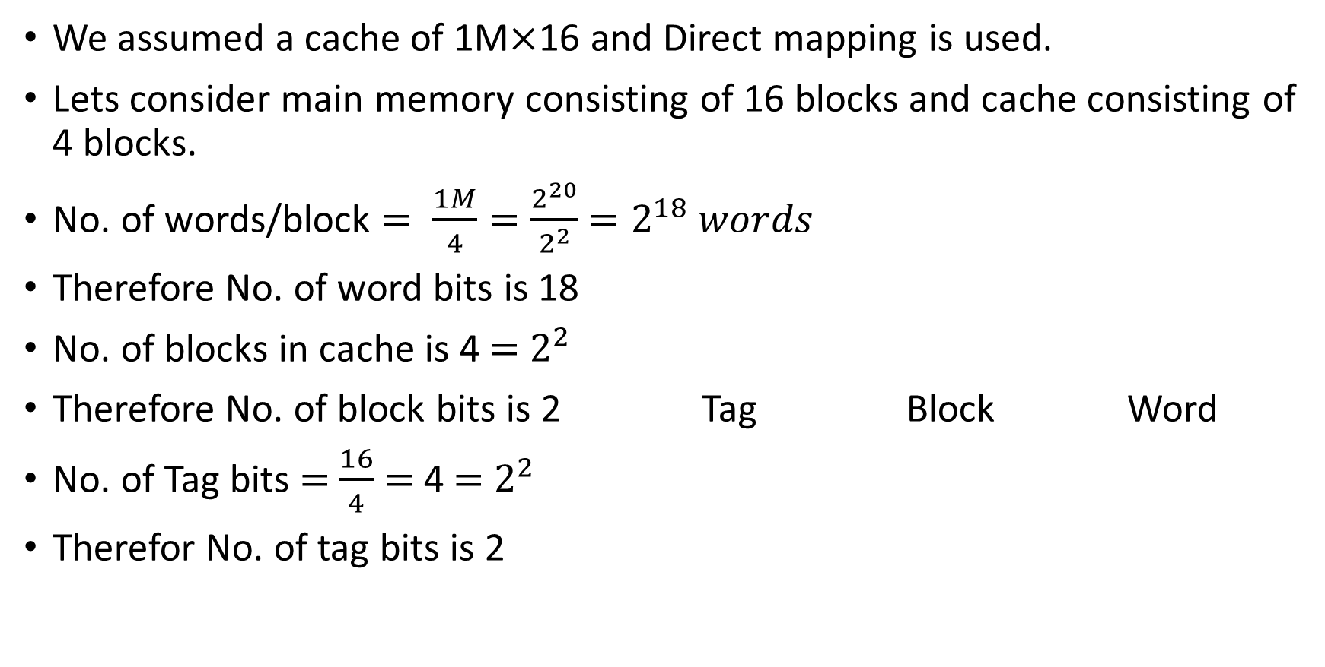
Cache design
We assumed a cache of 1M$×$16 and Direct mapping is used.
Lets consider main memory consisting of 16 blocks and cache consisting of 4 blocks.
No. of words/block $= \frac{1M}{4}=\frac{2^{20}}{2^{2}}$ $=2^{18} words$
Therefore No. of word bits is 18
No. of blocks in cache is 4 $=$ $2^{2}$
Therefore No. of block bits is 2 Tag Block Word
No. of Tag bits $=$ $\frac{16}{4}$ $=$ 4 $=$ $2^{2}$
Therefor No. of tag bits is 2
2 | 2 | 18

Slide 8
Functionalities of Components:
RAM cell: A memory storage unit used for reading and storing data at a given address location.
Decoder: A device which selects a given output line based on the input line.
Bit selector: Splits the bits as required into equal groups.
Buffer register: For temporary storage of input bits and to control its flow
Bit display: Converts binary number into a Decimal and displays it.
Bit splitter: Splits the bits individually and also can combines it.

Slide 9
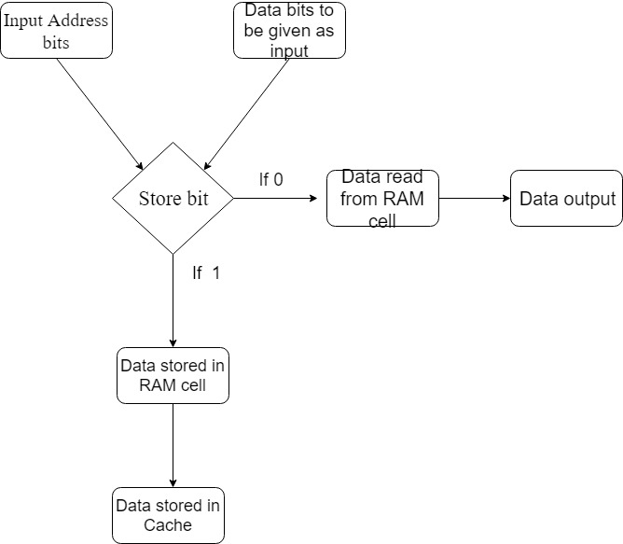
Block Diagram

Slide 10
Description:
18 bit address has to given as input.
Appropriate row has to be selected to read/write the data
For store: Make the store bit high. Enter the data bits. The data gets stored in the ram and cache memory.
For load: Make the store bit low. And desired address has to be given. The data present in that address appears at the output.
When the contents are changed in main memory they get reflected in cache also.

Slide 11
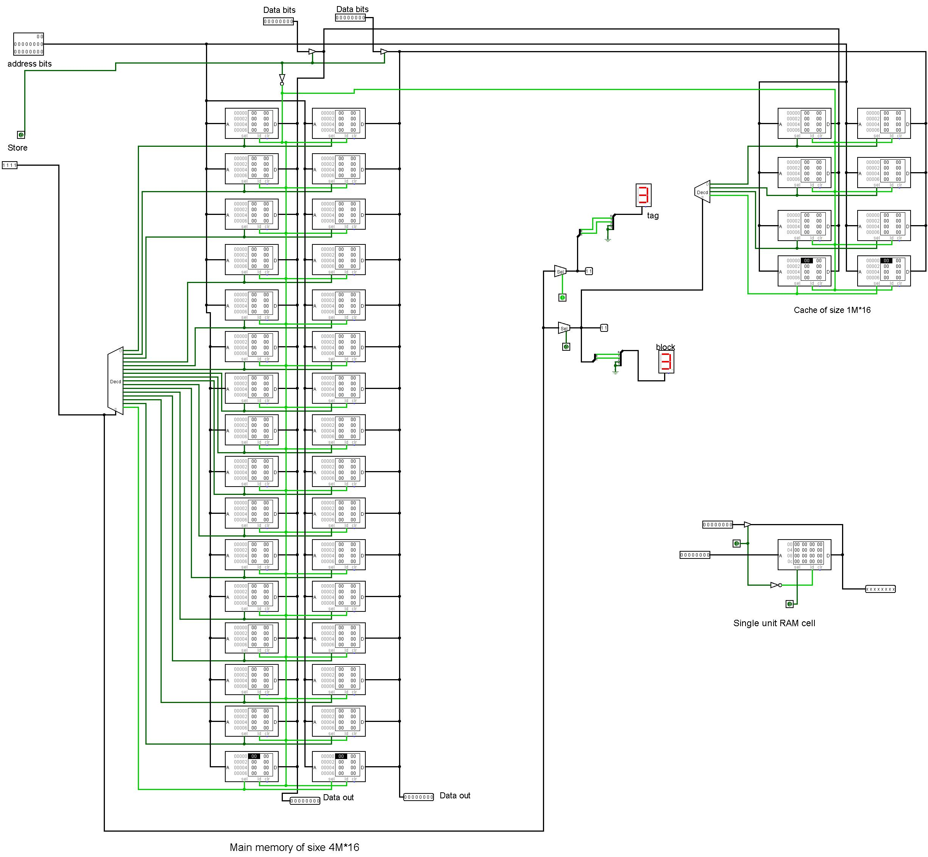
Main memory Design

Slide 12
Cache memory

Slide 13
Entire circuit diagram.

Slide 14
Thank You Tushar Pharale R.NO. 259 Ujwal Kumar R.NO. 260 Usman Khan R.NO. 261 V.K.Saketh R.NO. 263

